Slide 1
LPS DEVELOPMENT & IMPROVEMENTS PROJECT
JOHN DAY NORTH FISH LADDER ENTRANCE LPS
Issue: Gravity water supply alternatives
Ricardo Walker
Portland District FFDRWG Meeting
05 October 2017

Slide 2
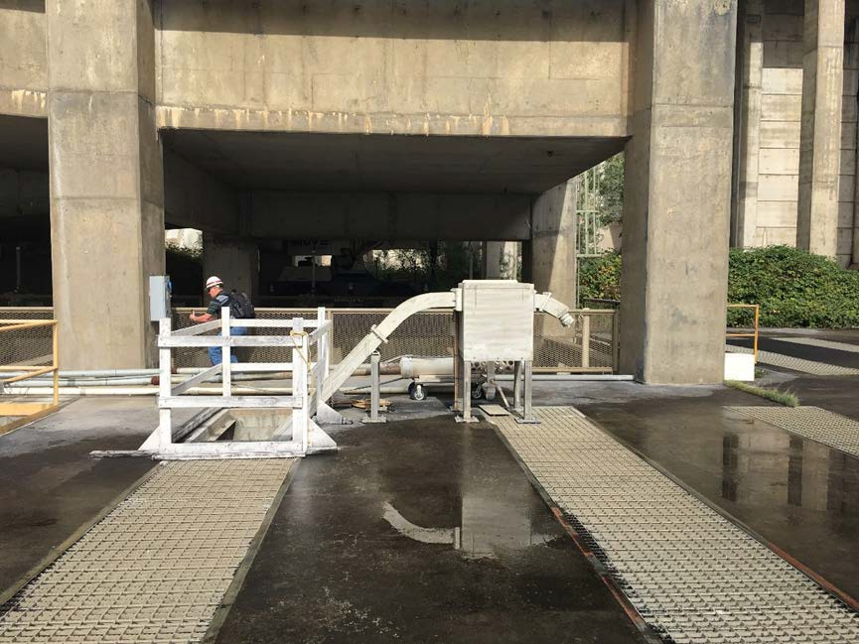
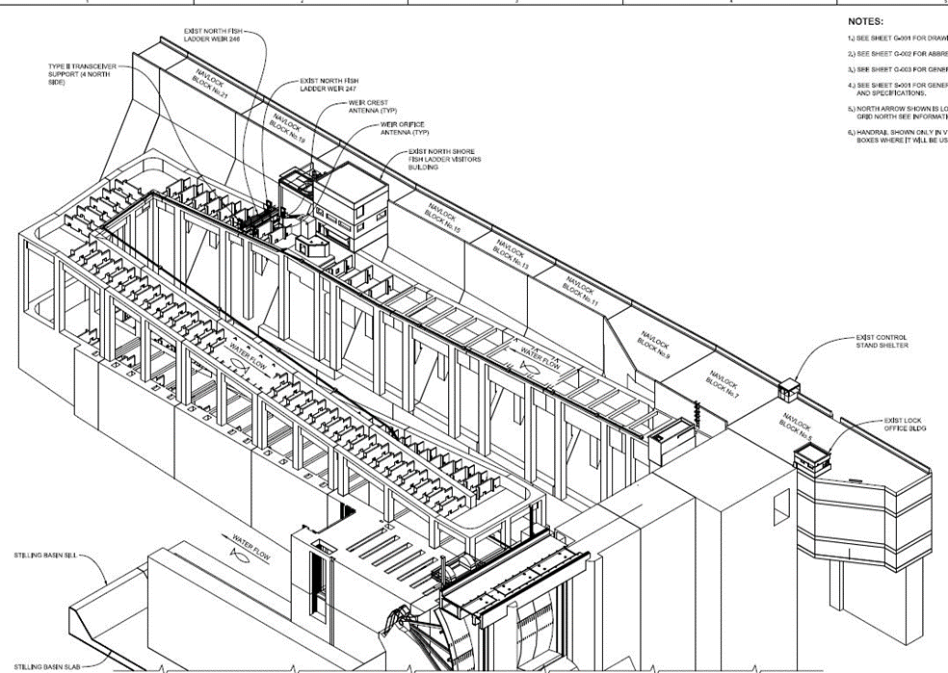

JOHN DAY DAM NORTH FISH LADDER ENTRANCE LPS

Slide 3
Concept
Minimize long-term O&M requirements and increase system reliability by installing a gravity water supply system for the LPS.
DESIGN FACTORS
Gravity water supply (from North Fish Ladder) must meet LPS flow requirements:
  150 gpm design flow; 124 gpm down flume; 15 gpm for the outfall; ~11 gpm to provide adjustability
Screening for water supply must meet NOAA fry criteria:
  ‘Active debris cleaning’ velocity maximum 0.4 ft/s
  ‘Passive debris cleaning’ velocity maximum 0.2 ft/s
  Note: An active system within the fishway is likely not acceptable
Location and shape of water supply intake and screen must minimize potential salmonid and lamprey interaction/entrainment risks and risks associated with debris.

Slide 4
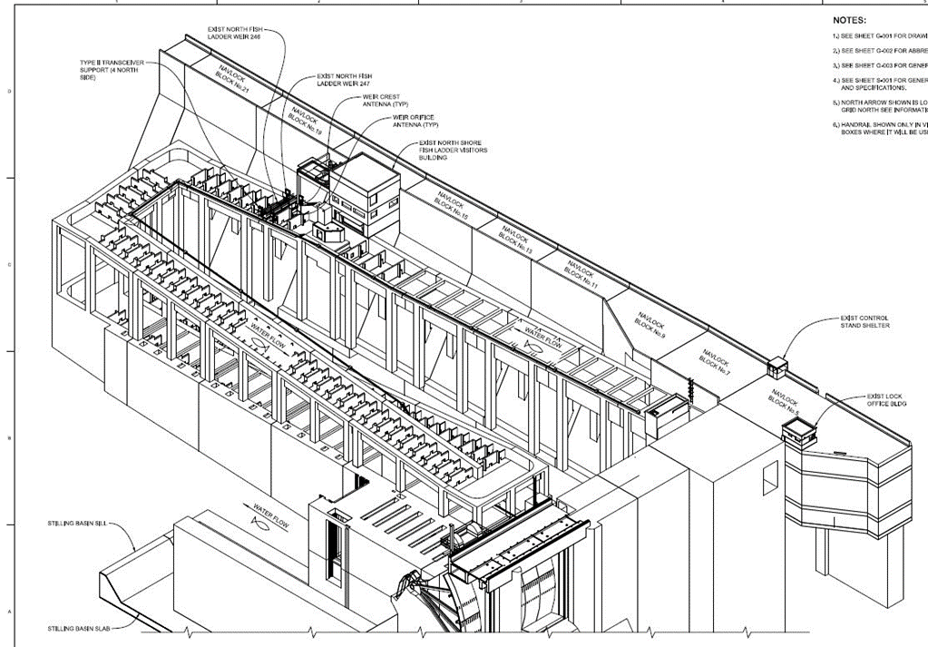
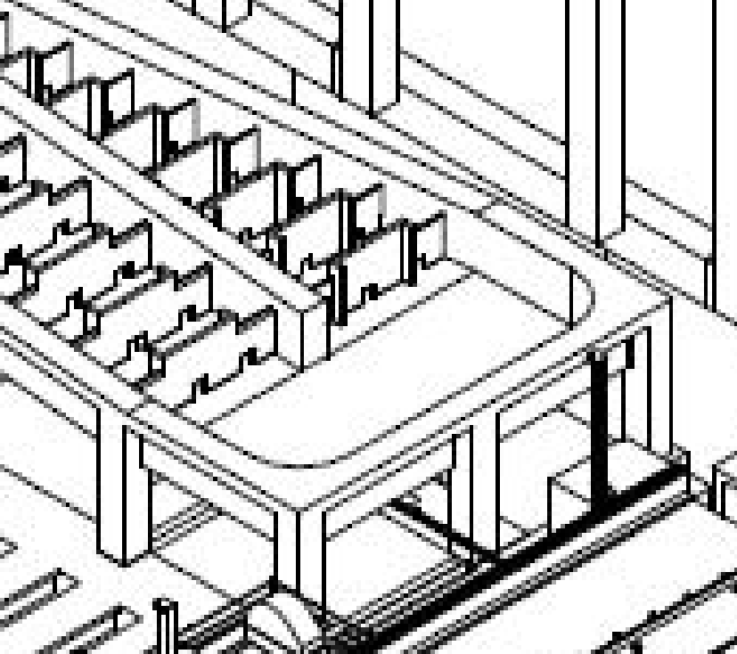
ALTERNATIVE 1 (Preferred)
Install intake in fish ladder at locations A, B, or C
Screen would be flush to the fishway wall
Intake size needed based on ladder flow and NOAA fry screen criteria
  12x12 inches or 14-in round for 0.4 ft/s active screen criteria
  16x16 inches or 18-in round for 0.2 ft/s passive
screen criteria
Assumptions
  Average ladder flow, normal ops, at location 85 cfs
    0.6 ft/s (6’ depth, 24’ width)
  Average ladder, shad ops, 123 cfs
    0.8 ft/s (6.3’ depth, 24’ width)
  Assume pipe size of 2 to 4-in (up to 2 pipes)
Concerns
  Structural – Don’t want to impact rebar
  Debris/clogging of passive screen
  New structure in fishway
C
A
B

Slide 5
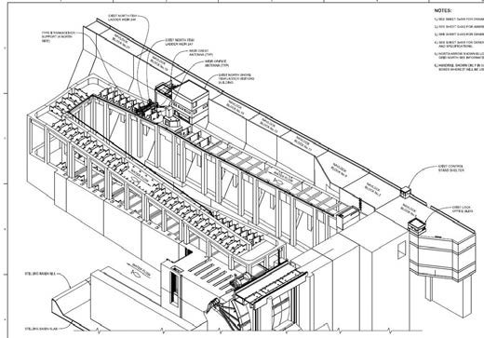
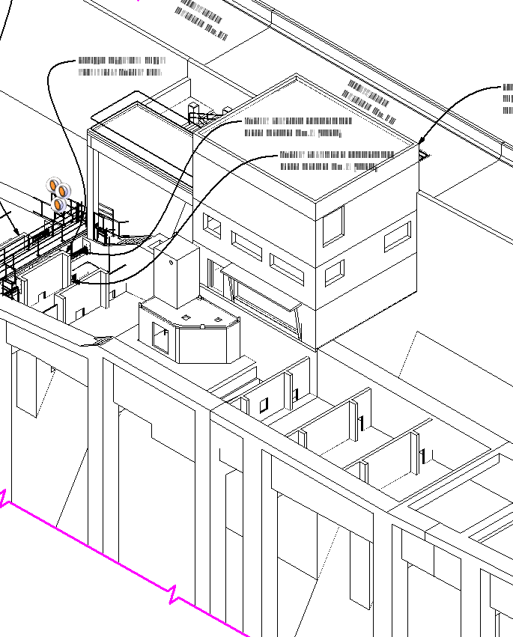
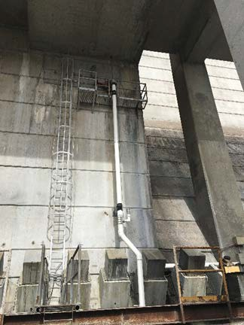
ALTERNATIVE 2
Add a second valve to existing 12-in fishway drain pipe (near count station)
Run PVC pipe with UV protective coating to LPS
Concerns
  Inlet to drain is only screened by
¾ inch diffuser grating
  Potential for small fish to enter drain

